Slide 1
CS 61C: Great Ideas in Computer Architecture Lecture 4: Memory Management
Krste Asanović & Randy Katz
http://inst.eecs.berkeley.edu/~cs61c

Slide 2
Agenda
Pointers to Pointers
Strings in C
C Memory Management
Stack
Heap
Implementations of malloc/free
Common memory problems & how to avoid/find them
And in Conclusion, …

Slide 3
Pointers to Pointers
Notes:
*p = 20

Slide 4
Your Turn …
int x[] = { 2, 4, 6, 8, 10 };
int *p = x;
int **pp = &p;
(*pp)++;
(*(*pp))++;
printf("%d\n", *p);
Name | Type | Addr | Value
 |  | …
 |  | 106
 |  | 105
 |  | 104
 |  | 103
 |  | 102
 |  | 101
 |  | 100
 |  | …
Answer
RED | 2
GREEN | 3
ORANGE | 4
YELLOW | 5

Slide 5
Agenda
Pointers to Pointers
Strings in C
C Memory Management
Stack
Heap
Implementations of malloc/free
Common memory problems & how to avoid/find them
And in Conclusion, …

Slide 6
C Strings
Type | Name | Byte Addr | Value
 |  | …
 |  | 108
 |  | 107
 |  | 106
 |  | 105
 |  | 104
 |  | 103
 |  | 102
 |  | 101
 |  | 100
 |  | …
C strings are null-terminated character arrays
char s[] = ”abc”;

Slide 7
String Example
Output: str = abc, length = 3

Slide 8
Concise strlen()
int strlen(char *s) {
char *p = s;
while (*p++)
; /* Null body of while */
return (p – s – 1);
}
What happens if there is no zero character at end of string?

Slide 9
Arguments in main()
To get arguments to the main function, use:
int main(int argc, char *argv[])
argc is the number of strings on the command line
argv is a pointer to an array containing the arguments as strings

Slide 10
Example
UNIX: $ gcc -o ex Argc.c
$ ./ex -g a "d e f”
arg[0] = ./ex
arg[1] = -g
arg[2] = a
arg[3] = d e f

Slide 11
Agenda
Pointers Wrap-up
Strings in C
C Memory Management
Stack
Heap
Implementations of malloc/free
Common memory problems & how to avoid/find them
And in Conclusion, …

Slide 12
C Memory Management
Sample Layout
(32-bit addresses)
How does the C compiler determine where to put code and data in the machine’s memory?
How can we create dynamically sized objects?
E.g. array of variable size depending on requirements
~ FFFF FFFF_{hex}
stack
currently unused but
available memory
heap
static data
code
~ 0000 0000_{hex}

Slide 13
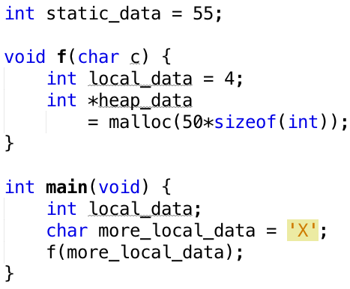
C Memory Management: Code
Sample Layout
(32-bit addresses)
Code
Loaded when program starts
Does not change
~ FFFF FFFF_{hex}
stack
currently unused but
available memory
heap
static data
code
~ 0000 0000_{hex}

Slide 14
C Memory Management: Static Data
Sample Layout
(32-bit addresses)
Static Data
Loaded when program starts
Can be modified
Size is fixed
~ FFFF FFFF_{hex}
stack
currently unused but
available memory
heap
static data
code
~ 0000 0000_{hex}

Slide 15
C Memory Management: Stack
Sample Layout
(32-bit addresses)
Stack
Local variables & arguments inside functions
Allocated when function is called
Stack usually grows downward
~ FFFF FFFF_{hex}
stack
currently unused but
available memory
heap
static data
code
~ 0000 0000_{hex}

Slide 16
C Memory Management: Heap
Sample Layout
(32-bit addresses)
Heap
Space for dynamic data
Allocated and freed by program as needed
~ FFFF FFFF_{hex}
stack
currently unused but
available memory
heap
static data
code
~ 0000 0000_{hex}

Slide 17
Agenda
Pointers Wrap-up
Strings in C
C Memory Management
Stack
Heap
Implementations of malloc/free
Common memory problems & how to avoid/find them
And in Conclusion, …

Slide 18
Stack
Frame main
Stack Pointer
Frame b
int arg;
int b_local;
Frame a
int a_local;
Stack Pointer
Stack Pointer
Frame b
int arg;
int b_local;
Stack Pointer

Slide 19
Stack
Every time a function is called, a new frame is allocated
When the function returns, the frame is deallocated
Stack frame contains
Function arguments
Local variables
Return address (who called me?)
Stack uses contiguous blocks of memory
Stack pointer indicates current level of stack
Stack management is transparent to C programmer
We’ll see details when we program assembly language

Slide 20
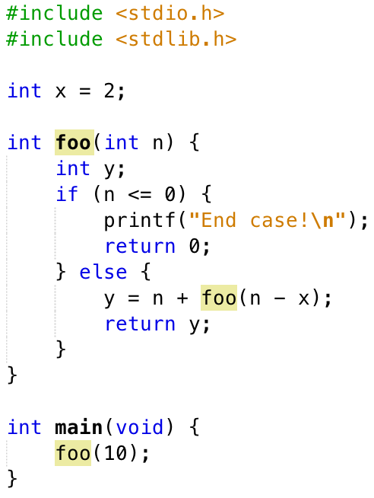
Your Turn …
Right after the printf executes but before the return 0, how many copies of x and y are allocated in memory?
Answer | #x | #y
RED | 1 | 1
GREEN | 1 | 6
ORANGE | 1 | 5
YELLOW | 6 | 6

Slide 21
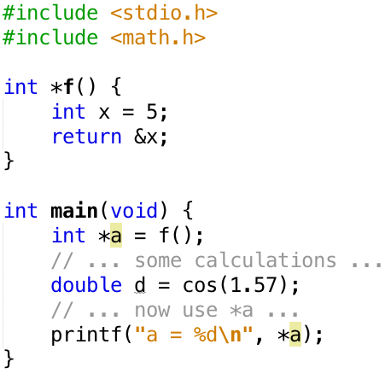
What’s wrong with this Code?
*a is a pointer to a local variable
allocated on the stack
“deallocated” when f() returns
stack reused by other functions
e.g. cos
which overwrite whatever was there before
*a points to “garbage”
Obscure errors
depend on what other functions are called after f() returns
assignments to *a corrupt the stack and can result in even more bizarre behavior than this example
errors can be difficult to reproduce
Output:
a = -1085663214

Slide 22
Agenda
Pointers Wrap-up
Strings in C
C Memory Management
Stack
Not on the test!
Heap
Implementations of malloc/free
Common memory problems & how to avoid/find them
And in Conclusion, …

Slide 23
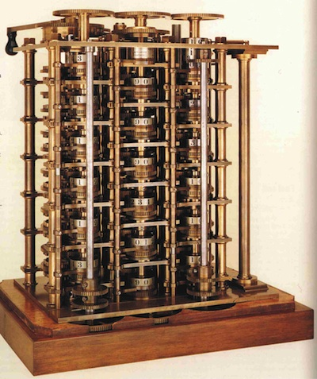
Early Memory Technology
Babbage, 1800s: Digits stored on mechanical wheels
Punched cards, From early 1700s through Jaquard Loom, Babbage, and then IBM

Slide 24
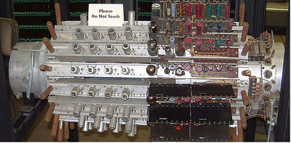
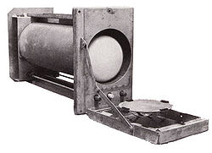
Early Memory technology
Mercury Delay Line, Univac 1, 1951
Punched paper tape, instruction stream in Harvard Mk 1
Williams Tube, Manchester Mark 1, 1947

Slide 25
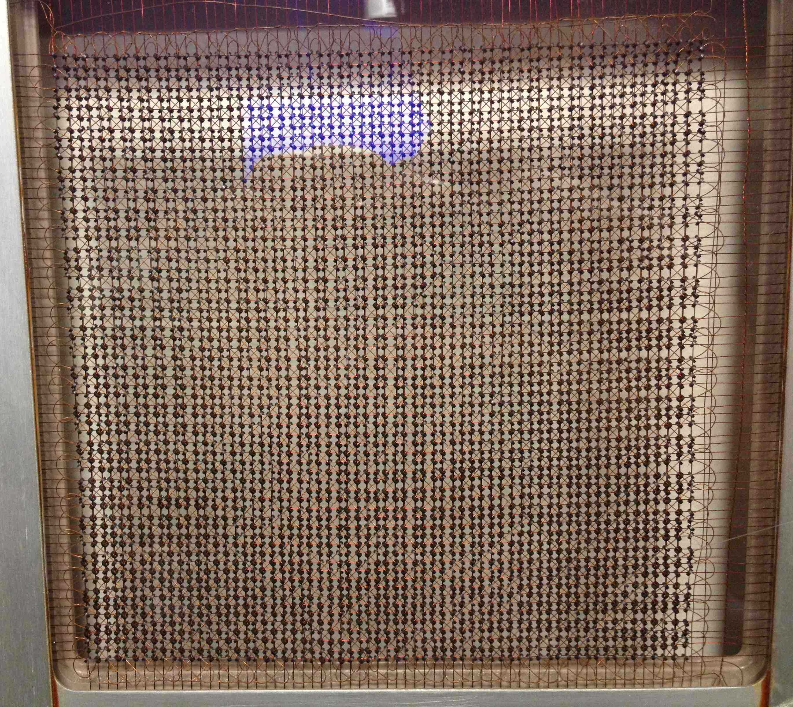
MIT Whirlwind Core Memory

Slide 26
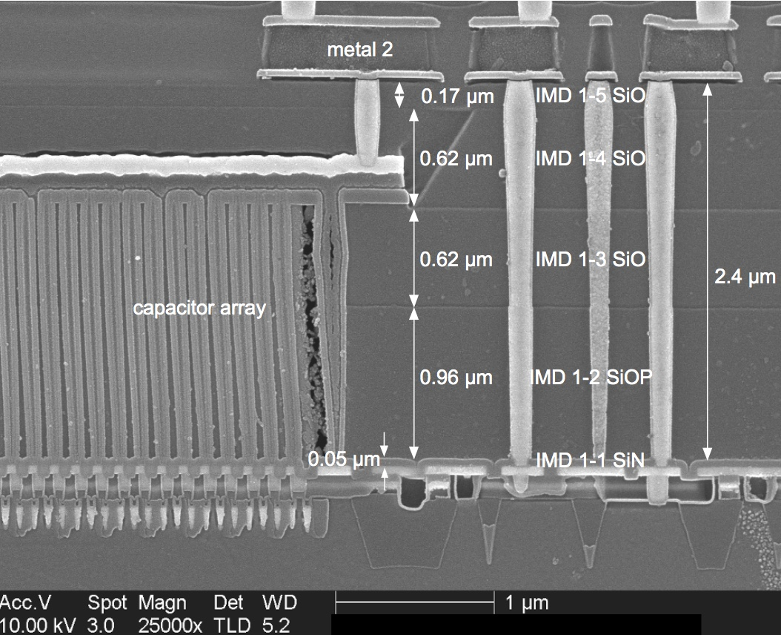
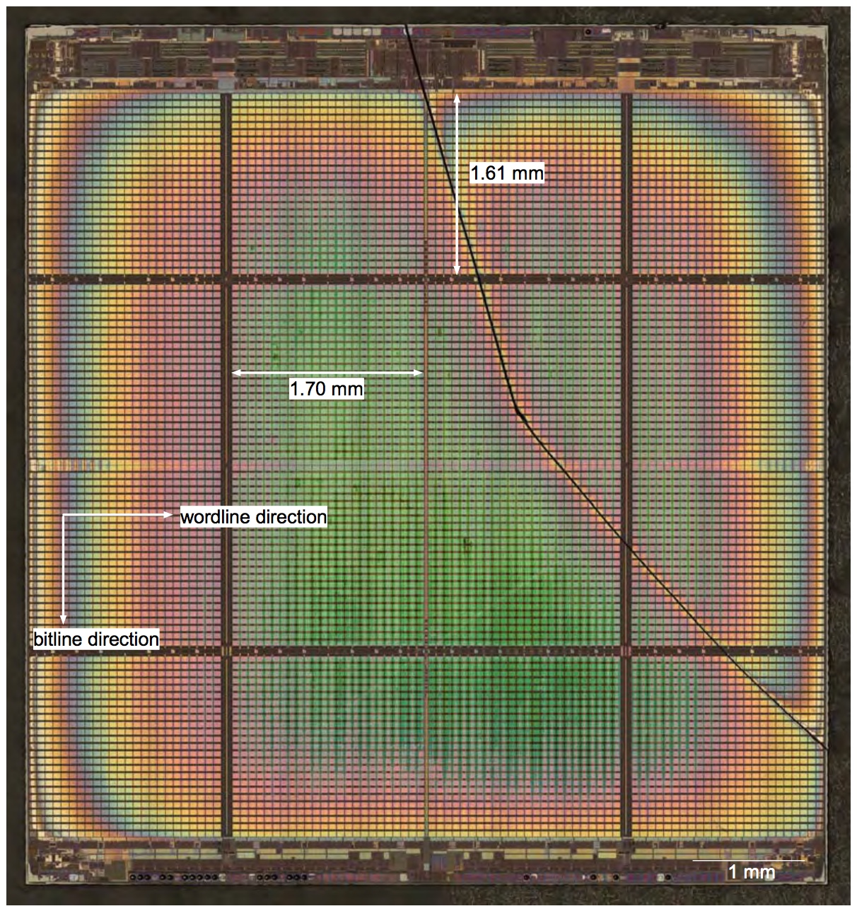
Modern DRAM Technology
46nm DDR2 DRAM [© Chipworks]

Slide 27
Break!

Slide 28
Agenda
Pointers Wrap-up
Strings in C
C Memory Management
Stack
Heap
Implementations of malloc/free
Common memory problems & how to avoid/find them
And in Conclusion, …

Slide 29
Managing the Heap
C functions for heap management:
malloc() allocate a block of uninitialized memory
calloc() allocate a block of zeroed memory
free() free previously allocated block of memory
realloc() change size of previously allocated block
Beware: previously allocated contents might move!

Slide 30
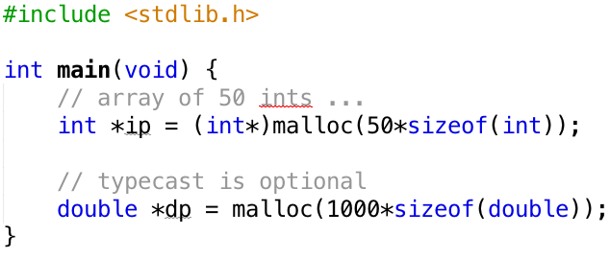
Malloc()
void *malloc(size_t n):
Allocate a block of uninitialized memory
n is an integer, indicating size of requested memory block in bytes
size_t is an unsigned integer type big enough to “count” memory bytes
Returns void* pointer to block
NULL return indicates no more memory
Example:
Notes:
sizeof also works with structs
always use sizeof since only god and the compiler know how big an object is

Slide 31
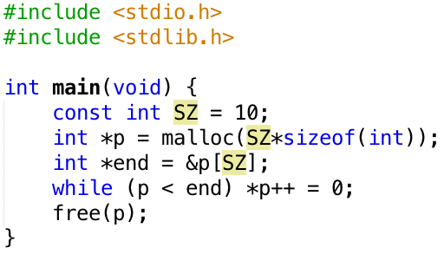
What’s wrong with this Code?
$ gcc FreeBug.c; ./a.out
a.out(23562,0x7fff78748000) malloc:
*** error for object 0x7fdcb3403168:
pointer being freed was not allocated
*** set a breakpoint in malloc_error_break to debug
Abort trap: 6

Slide 32
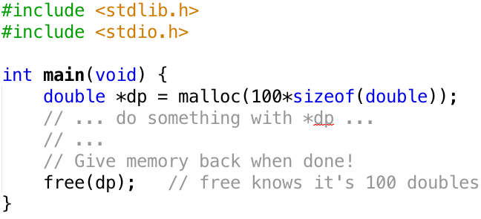
free()
void free(void *p):
Release memory allocated by malloc()
p must contain address originally returned by malloc()
Example:

Slide 33
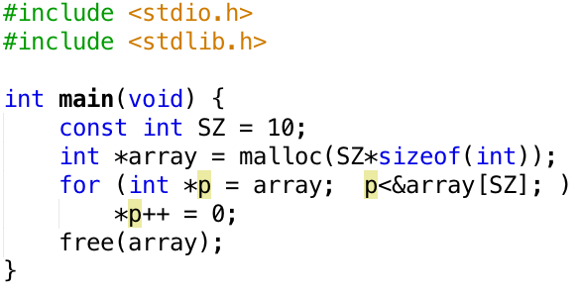
Fix
Do not modify return value from malloc
You’ll need it to call free!

Slide 34
Why Call free()?
Recycle no-longer-used memory to avoid running out
Two common approaches:
malloc/free (Explicit memory management)
C, C++, …
”manually” take care of releasing memory
Requires some planning: how do I know that memory is no longer used? What if I forget to release?
Drawback: potential bugs
memory leaks (forgot to call free)
corrupted memory (accessing memory that is now longer “owned”)
garbage collector (Automatic memory management)
Java, Python, …
No-longer-used memory is free’d automatically
Drawbacks:
performance hit
unpredictable:
what if garbage collector starts when a self-driving car enters a turn at 100mph?

Slide 35
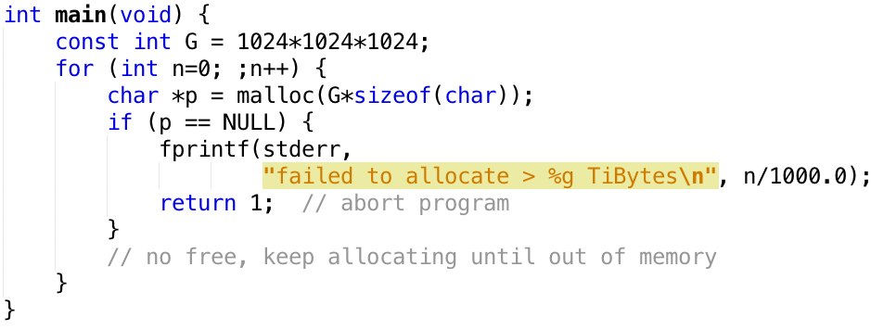
Out of Memory
Insufficient free memory: malloc() returns NULL
$ gcc OutOfMemory.c; ./a.out
failed to allocate > 131.064 TiBytes
Notes:
error, not NULL
but allocated 131 Tbytes!!!
on my laptop
and did this fast!
how much memory does your computer have?
How? One of the many things 61C will tell you!

Slide 36
Example: Dynamically Allocated Tree
Root
Key=10
Left
Right
Key=5
Key=16
Left
Right
Left
Right
Key=11
Left
Right
Notes:
Adding free in general is non-trivial. E.g. imagine an application which shares sub-trees between different trees.
How are nodes used in a real application?
Need a plan before starting to program!
(skip this unless lots of time)

Slide 37
malloc and free are buddies!
malloc and free
no malloc, no free
If you call malloc somewhere, you’ll need to call free on the result (or accept having memory leak)
E.g.
int *p = malloc(…);
// potentially very
// complicated code
// when done, call:
free(p);
If you have not called malloc, do not call free!
E.g.
int x;
int *p = &x;
// do whatever with p,
// but do not call free!
int a[5];
// do whatever with a, but
// do not call free(a)!

Slide 38
Observations
Code, Static storage are easy:
they never grow or shrink
taken care of by OS
Stack space is relatively easy:
stack frames are created and destroyed in last-in, first-out (LIFO) order
transparent to programmer
but don’t hold onto it (with pointer) after function returns!
Managing the heap is the programmer’s task:
memory can be allocated / deallocated at any time
how tell / ensure that a block of memory is no longer used anywhere in the program?
requires planning before coding …
Notes:
managing memory of complex programs, e.g. Python interpreter or OS, in C is not trivial …

Slide 39
Agenda
Pointers Wrap-up
Strings in C
C Memory Management
Stack
Heap
Implementations of malloc/free
Common memory problems & how to avoid/find them
And in Conclusion, …

Slide 40
How are Malloc/Free implemented?
Underlying operating system allows malloc library to ask for large blocks of memory to use in heap
E.g., using Unix sbrk() call
C standard malloc library creates data structure inside unused portions of the heap to track free space
Writing to unallocated (or free’d) memory can corrupt this data structure.
Whose fault is it? The library’s?

Slide 41
Simple malloc() Implementation
Initial Empty Heap space from Operating System
Free Space
Malloc library creates linked list of empty blocks (one block initially)
Free
Object 1
First allocation chews up space from start of free space
Free
Problems after many malloc’s and free’s:
Memory fragmentation (many small and no big free blocks, merge?)
Long chain of blocks (slow to traverse)

Slide 42
Better malloc Implementations
Keep separate pools of blocks for different sized objects
E.g. “Buddy allocators” always round up to power-of-2 sized chunks to simplify finding correct size and merging neighboring blocks
https://en.wikipedia.org/wiki/Buddy_memory_allocation

Slide 43
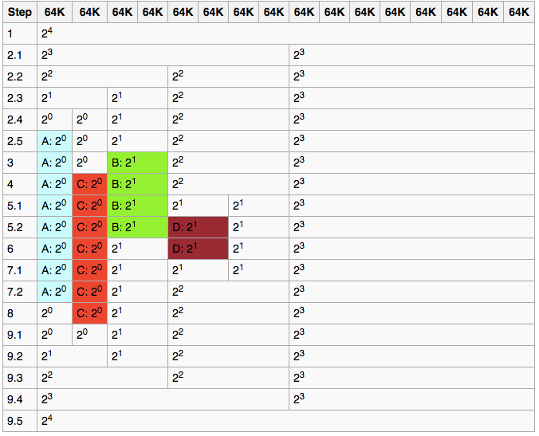
Power-of-2 “Buddy Allocator”
Time
https://en.wikipedia.org/wiki/Buddy_memory_allocation
Notes:
Minimum block: 64kB (tradeoff overhead and wasted memory, 64kB sounds big)
1 block size 2^4*64kB
Request A for 34kB
2.1) Split 2^4 into 2 blocks of 2^3 x 64kB each
2.2 … 2.4) Keep splitting util 2 blocks of 2^0 x 64kB, and one each of 2^1, 2^2, 2^3 * 64kB
2.5) Allocated one of the 2^0*64kB blocks to A
3) B asks for 66k, give it available 2^1 x 64kB block
4) C asks for 35k. give it available 2^0 block
5.1) D asks for 67k
5.2) split 2^2 block into two 2^1 blocks and hand one to D
6) B frees
7.1) D frees
7.2) merge adjacient (buddy) 2^1 into one 2^2 block
8) A frees
9.x) C frees, merge into 1 2^4 block

Slide 44
Agenda
Pointers Wrap-up
Strings in C
C Memory Management
Stack
Heap
Implementations of malloc/free
Common memory problems & how to avoid/find them
And in Conclusion, …

Slide 45
Common Memory Problems
Using uninitialized values
Using memory that you don’t own
De-allocated stack or heap variable
Out-of-bounds reference to array
Using NULL or garbage data as a pointer
Improper use of free/realloc by messing with the pointer returned by malloc/calloc
Memory leaks
you allocated something but forgot to free it later

Slide 46
Assignment to free’d Memory
Code
Output
$ gcc test.c
$ ./a.out
a=55, b=55 (==128!)
Assignment to a corrupts b
or something else happens that is even more undesirable
Error may go undetected!
Notes:
Big problem is that the error may go undetected during testing

Slide 47
“Defensive” Programming
Code
Output
$ ./a.out
Segmentation fault: 11
Problem is evident
But where is the error?
May not be obvious in a BIG program

Slide 48
Debugger (gdb)
$ gcc -g DefensiveB.c
$ gdb a.out
GNU gdb (GDB) 7.11.1
Copyright (C) 2016 Free Software Foundation, Inc.
Reading symbols from a.out...Reading symbols from /a.out.dSYM/Contents/Resources/DWARF/a.out...done.
(gdb) run
Starting program: /defensiveB/a.out
Program received signal SIGSEGV, Segmentation fault.
0x0000000100000f76 in main () at DefensiveB.c:11
11 *a = 55;
(gdb)

Slide 49
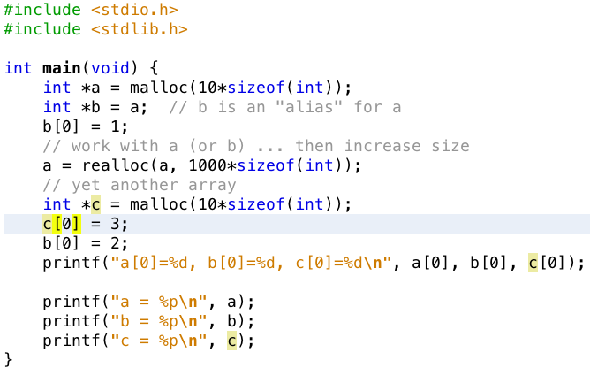
What’s wrong with this code?
Warning:
This particular result (with realloc) is a coincidence. If run again, or on a different computer, the result may differ.
After realloc, b is no longer valid and points to memory it does not own.
Using b after calling realloc is a BUG. Do not program like this!
Output:
a[0]=1, b[0]=2, c[0]=2
a = 0x7fc53b802600
b = 0x7fc53b403140
c = 0x7fc53b403140
Output: realloc commented out
a[0]=2, b[0]=2, c[0]=3
a = 0x7f9bdbc04be0
b = 0x7f9bdbc04be0
c = 0x7f9bdbc04c10
Notes:
a moves when realloc is called
b is no longer valid!!! (by chance it now points to c, but it could point to something else just as well)
no guarantee that error occurs.
E.g. for realloc(va, 20), the array does not move on my computer (depends on implementation of heap)

Slide 50
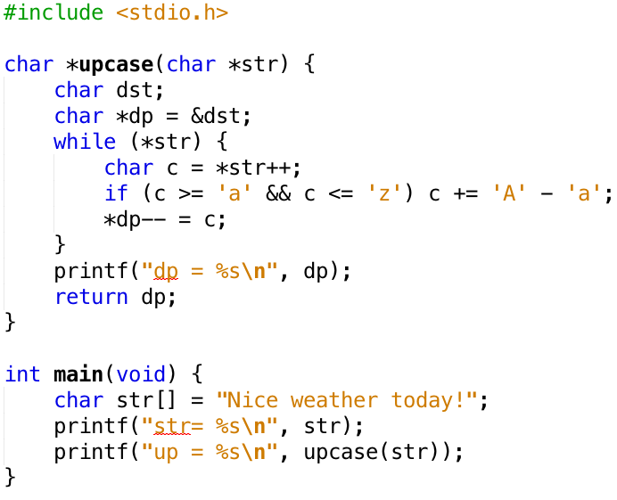
How many errors in this code?

Slide 51
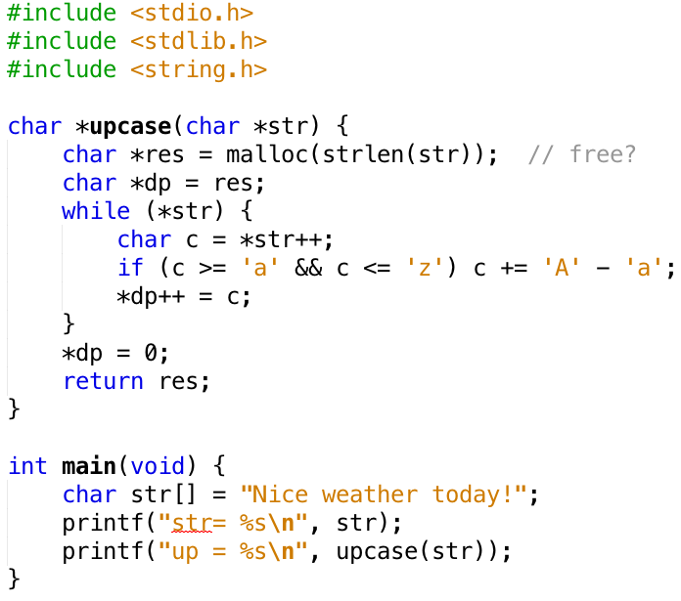
Upcase Fixed
Still need strategy for freeing
memory. Caller is responsible …
Output:
str= Nice weather today!
up = NICE WEATHER TODAY!

Slide 52
What’s wrong with this Code?
typedef struct node {
struct node* next;
int val;
} Node;
int findLastNodeValue(Node* head) {
while (head->next != NULL) {
head = head->next;
}
return head->val;
}
Notes:
Explicit memory management and pointer arithmetic present opportunities for designing compact and efficient programs. However, incorrect use of these features can lead to complex defects, such as a pointer referring to memory that you don't own. In this case, too, reading memory through such pointers may give garbage value or cause segmentation faults and core dumps, and using garbage values can cause unpredictable program behavior or crashes.
Null Pointer Read/Write (NPR, NPW) and Zero Page Read/Write (ZPR, ZPW):
If a pointer's value can potentially be null (NULL), the pointer should not be de-referenced without checking it for being null. For example, a call to malloc can return a null result if no memory is available. Before using the pointer returned by malloc, you need to check it to make sure that isn't null. For example, a linked list or tree traversal algorithm needs to check whether the next node or child node is null.
It is common to forget these checks. Valgrind detects any memory access through de-referencing a null pointer, and reports an NPR or NPW error. When you see this error, examine whether you need to add a null pointer check or whether you wrongly assumed that your program logic guaranteed a non-null pointer. On AIX, HP, and under some linker options in Solaris, dereferencing a null pointer produces a zero value, not a segmentation fault signal.
The memory is divided into pages, and it is "illegal" to read from or write to a memory location on the zero'th page. This error is typically due to null pointer or incorrect pointer arithmetic computations. For example, if you have a null pointer to a structure and you attempt to access various fields of that structure, it will lead to a zero page read error, or ZPR.
Shows a simple example of both NPR and ZPR problems. The findLastNodeValue method has a defect, in that it does not check whether the head parameter is null. NPR and ZPR errors occur when the next and val fields are accessed, respectively.

Slide 53
Administrivia
Last call for instructional accounts: today at midnight
Fill out the Inst Acct Google Form on Piazza
Homework 0 due this Friday
Mini-Bio due before discussion section
You may choose to go to any discussion section but remember that sticking with 1 TA is better for EPA
Weekly tutoring/Guerrilla sessions will begin next week!

Slide 54
Break!

Slide 55
http://valgrind.org
Notes:
detect many memory management bugs
no magic wand
but tools can help

Slide 56
Valgrind Example

Slide 57
Valgrind Output (abbreviated)
$ gcc -o test -g -O0 test.c
$ valgrind --leak-check=yes ./test
==8724== Memcheck, a memory error detector
==8724==
==8724== Invalid write of size 4
==8724== at 0x100000F5C: f (test.c:5)
==8724== by 0x100000F83: main (test.c:9)
==8724==
==8724== HEAP SUMMARY:
==8724==
==8724== 40 bytes in 1 blocks are definitely lost …
==8724== at 0x100008EBB: malloc …
==8724== by 0x100000F53: f (test.c:4)
==8724== by 0x100000F83: main (test.c:9)
==8724==
==8724== LEAK SUMMARY:
==8724== definitely lost: 40 bytes in 1 blocks
==8724== indirectly lost: 0 bytes in 0 blocks

Slide 58
Classification of Bugs
Bohrbugs
Heisenbugs
Executing faulty code produces error
syntax errors
algorithmic errors (e.g. sort)
dereferencing NULL
“Easily” reproducible
Diagnose with standard debugging tools, e.g. gdb
Executing faulty code may not result in error
uninitialized variable
writing past array boundary
Difficult to reproduce
Hard to diagnose with standard tools
Defensive programming & Valgrind attempt to convert Heisenbugs to Bohrbugs
crash occurs during testing, not $&^#!
Disclaimer: classification is controversial. Just do not write buggy programs …
Ref: J. Gray, Why do computers stop and what can be done about them?, Tandem TR 85.7

Slide 59
Agenda
Pointers Wrap-up
Strings in C
C Memory Management
Stack
Heap
Implementations of malloc/free
Common memory problems & how to avoid/find them
And in Conclusion, …

Slide 60
And in Conclusion …
C has three main memory segments to allocate data:
Static Data: Variables outside functions (globals)
Stack: Variables local to function
Heap: Memory allocated explicitly with malloc/free
Heap data is an exceptionally fertile ground for bugs
memory leaks & corruption
send me your best examples (EPA credit? - you paid for them!)
Strategies:
Planning:
Who “owns” malloc’d data?
Often more than one ”owner” (pointer) to same data
Who can safely call free?
Defensive programming, e.g.
Assign NULL to free’d pointer
Use const’s for array size
Tools, e.g.
gdb, Valgrind
Aren’t they cute?
Notes:
aren’t they cute?

Slide 61
Additional Examples of C Memory Errors (to peruse at your leisure)

Slide 62
Using Memory You Don’t Own
What is wrong with this code?
int *ipr, *ipw;
void ReadMem() {
int i, j;
ipr = (int *) malloc(4 * sizeof(int));
i = *(ipr - 1000); j = *(ipr + 1000);
free(ipr);
}
void WriteMem() {
ipw = (int *) malloc(5 * sizeof(int));
*(ipw - 1000) = 0; *(ipw + 1000) = 0;
free(ipw);
}
Notes:
Invalid Pointer Read or Write (IPR, IPW):
Valgrind tracks all memory operations. When it detects a pointer to a memory location that has not been allocated to the program, it reports either an IPR or IPW error, depending on whether it was a read or write operation. The error can happen for multiple reasons. For example, you will get this type of error if you have an uninitialized pointer variable and the garbage value happens to be invalid. As another example, if you wanted to do *pi = i;, where pi is a pointer to an integer and i is an integer. But, by mistake, you didn't type the * and wrote just pi = i;. With the help of implicit casting, an integer value is copied as a pointer value. When you dereference pi again, you may get an IPR or IPW error. This can also happen when pointer arithmetic results in an invalid address, even when it is not on the zero'th page.

Slide 63
Using Memory You Don’t Own
Using pointers beyond the range that had been malloc’d
May look obvious, but what if mem refs had been result of pointer arithmetic that erroneously took them out of the allocated range?
int *ipr, *ipw;
void ReadMem() {
int i, j;
ipr = (int *) malloc(4 * sizeof(int));
i = *(ipr - 1000); j = *(ipr + 1000);
free(ipr);
}
void WriteMem() {
ipw = (int *) malloc(5 * sizeof(int));
*(ipw - 1000) = 0; *(ipw + 1000) = 0;
free(ipw);
}
Notes:
Invalid Pointer Read or Write (IPR, IPW):
Valgrind tracks all memory operations. When it detects a pointer to a memory location that has not been allocated to the program, it reports either an IPR or IPW error, depending on whether it was a read or write operation. The error can happen for multiple reasons. For example, you will get this type of error if you have an uninitialized pointer variable and the garbage value happens to be invalid. As another example, if you wanted to do *pi = i;, where pi is a pointer to an integer and i is an integer. But, by mistake, you didn't type the * and wrote just pi = i;. With the help of implicit casting, an integer value is copied as a pointer value. When you dereference pi again, you may get an IPR or IPW error. This can also happen when pointer arithmetic results in an invalid address, even when it is not on the zero'th page.

Slide 64
Faulty Heap Management
What is wrong with this code?
int *pi;
void foo() {
pi = malloc(8*sizeof(int));
…
free(pi);
}
void main() {
pi = malloc(4*sizeof(int));
foo();
…
}
Notes:
First, in the method foo, the pointer pi is overwritten with a new memory allocation, and all pointers to the old memory block are lost.
This results in leaking the memory block that was allocated in method main. Valgrind reports a memory leak (MLK) and specifies the line where the leaked memory was allocated. It eliminates the slow process of hunting down the memory block that is leaking, therefore shortens the debugging time. You can start debugging at the memory allocation site where the leak is reported, and then track what you are doing with that pointer and where you are overwriting it.
Later, the method foo frees up the memory it has allocated, but the pointer pi still holds the address (it is not set to null). After returning from method foo to main, when you use the pointer pi, it refers to the memory that has already been freed, so pi becomes a dangling pointer. Valgrind promptly reports a FMW error at that location.
Using faulty heap memory management
Explicit memory management in C and C++ programming puts the onus of managing memory on the programmers. Therefore, you must be vigilant while allocating and freeing heap memory. These are the common memory management mistakes:
Memory leaks and potential memory leaks (MLK, PLK, MPK)
Freeing invalid memory (FIM)
Freeing mismatched memory (FMM)
Freeing non-heap memory (FNH)
Freeing unallocated memory (FUM)
Memory leaks and potential memory leaks:
When all pointers to a heap memory block are lost, that is commonly called a memory leak. With no valid pointer to that memory, there is no way you can use or release that memory. You lose a pointer to a memory when you overwrite it with another address, or when a pointer variable goes out of the scope, or when you free a structure or an array that has pointers stored in it. Valgrind scans all of the memory and reports all memory blocks without any pointers pointing to them as memory leaks (MLK). In addition, it reports all blocks as potential leaks, or PLK (called MPK on Windows platforms) when there are no pointers to the beginning of the block but there are pointers to the middle of the block.
Linsting 9 shows a simple example of a memory leak and a heap dangling pointer. In this example, interestingly, methods foo and main independently seem to be error-free, but together they manifest both errors. This example demonstrates that interactions between methods may expose multiple flaws that you may not find simply by inspecting individual functions. Real-world applications are very complex, thus tedious and time-consuming for you to inspect and to analyze the control flow and its consequences. Using Valgrind gives you vital help in detecting errors in such situations.

Slide 65
Faulty Heap Management
Memory leak: more mallocs than frees
int *pi;
void foo() {
pi = malloc(8*sizeof(int));
/* Allocate memory for pi */
/* Oops, leaked the old memory pointed to by pi */
…
free(pi);
}
void main() {
pi = malloc(4*sizeof(int));
foo(); /* Memory leak: foo leaks it */
…
}
Notes:
Using faulty heap memory management
Explicit memory management in C and C++ programming puts the onus of managing memory on the programmers. Therefore, you must be vigilant while allocating and freeing heap memory. These are the common memory management mistakes:
Memory leaks and potential memory leaks (MLK, PLK, MPK)
Freeing invalid memory (FIM)
Freeing mismatched memory (FMM)
Freeing non-heap memory (FNH)
Freeing unallocated memory (FUM)
Memory leaks and potential memory leaks:
When all pointers to a heap memory block are lost, that is commonly called a memory leak. With no valid pointer to that memory, there is no way you can use or release that memory. You lose a pointer to a memory when you overwrite it with another address, or when a pointer variable goes out of the scope, or when you free a structure or an array that has pointers stored in it. Valgrind scans all of the memory and reports all memory blocks without any pointers pointing to them as memory leaks (MLK). In addition, it reports all blocks as potential leaks, or PLK (called MPK on Windows platforms) when there are no pointers to the beginning of the block but there are pointers to the middle of the block.
Linsting 9 shows a simple example of a memory leak and a heap dangling pointer. In this example, interestingly, methods foo and main independently seem to be error-free, but together they manifest both errors. This example demonstrates that interactions between methods may expose multiple flaws that you may not find simply by inspecting individual functions. Real-world applications are very complex, thus tedious and time-consuming for you to inspect and to analyze the control flow and its consequences. Using Valgrind gives you vital help in detecting errors in such situations.
First, in the method foo, the pointer pi is overwritten with a new memory allocation, and all pointers to the old memory block are lost. This results in leaking the memory block that was allocated in method main. Valgrind reports a memory leak (MLK) and specifies the line where the leaked memory was allocated. It eliminates the slow process of hunting down the memory block that is leaking, therefore shortens the debugging time. You can start debugging at the memory allocation site where the leak is reported, and then track what you are doing with that pointer and where you are overwriting it.
Later, the method foo frees up the memory it has allocated, but the pointer pi still holds the address (it is not set to null). After returning from method foo to main, when you use the pointer pi, it refers to the memory that has already been freed, so pi becomes a dangling pointer. Valgrind promptly reports a FMW error at that location.

Slide 66
Faulty Heap Management
What is wrong with this code?
int *plk = NULL;
void genPLK() {
plk = malloc(2 * sizeof(int));
… … …
plk++;
}
Notes:
Listing 10 shows an example of a potential memory leak. After incrementing pointer plk, it points to the middle of the memory block, but there is no pointer pointing to the beginning of that memory block. Therefore, a potential memory leak is reported at the memory allocation site for that block.

Slide 67
Faulty Heap Management
Potential memory leak – handle (block pointer) has been changed, do you still have copy of it that can correctly be used in a later free?
int *plk = NULL;
void genPLK() {
plk = malloc(2 * sizeof(int));
… … …
plk++; /* Potential leak: pointer variable incremented past beginning of block! */
}
Notes:
Listing 10 shows an example of a potential memory leak. After incrementing pointer plk, it points to the middle of the memory block, but there is no pointer pointing to the beginning of that memory block. Therefore, a potential memory leak is reported at the memory allocation site for that block.

Slide 68
Faulty Heap Management
What is wrong with this code?
void FreeMemX() {
int fnh = 0;
free(&fnh);
}
void FreeMemY() {
int *fum = malloc(4 * sizeof(int));
free(fum+1);
free(fum);
free(fum);
}
Notes:
Freeing invalid memory:
This error occurs whenever you attempt to free memory that you are not allowed to free. This may happen for various reasons: allocating and freeing memory through inconsistent mechanisms, freeing a non-heap memory (say, freeing a pointer that points to stack memory), or freeing memory that you haven't allocated. When using Valgrind for the Windows platform, all such errors are reported as freeing invalid memory (FIM). On the UNIX® system, Valgrind further classifies these errors by reporting freeing mismatched memory (FMM), freeing non-heap memory (FNH), and freeing unallocated memory (FUM) to indicate the exact reason for the error.
Freeing mismatched memory (FMM) is reported when a memory location is de-allocated by using a function from a different family than the one used for allocation. For example, you use new operator to allocate memory, but use method free to de-allocate it. Valgrind checks for the following families, or matching pairs:
malloc() / free()
calloc() / free()
realloc() / free()
operator new / operator delete
operator new[] / operator delete[]
Valgrind reports any incompatible use of memory allocation and de-allocation routine as an FMM error. In the example in Listing 11, the memory was allocated using the malloc method but freed using the delete operator, which is not the correct counterpart, thus incompatible. Another common example of an FMM error is C++ programs that allocate an array using the new[] operator, but free the memory using a scalar delete operator instead of array delete[] operator. These errors are hard to detect through code inspection, because the memory allocation and de-allocation locations may not be located close to each other, and because there is no difference in syntax between an integer pointer and a pointer to an integer array.

Slide 69
Faulty Heap Management
Can’t free non-heap memory; Can’t free memory that hasn’t been allocated
void FreeMemX() {
int fnh = 0;
free(&fnh); /* Oops! freeing stack memory */
}
void FreeMemY() {
int *fum = malloc(4 * sizeof(int));
free(fum+1); /* fum+1 is not a proper handle; points to middle of a block */
free(fum);
free(fum); /* Oops! Attempt to free already freed memory */
}
Notes:
Freeing invalid memory:
This error occurs whenever you attempt to free memory that you are not allowed to free. This may happen for various reasons: allocating and freeing memory through inconsistent mechanisms, freeing a non-heap memory (say, freeing a pointer that points to stack memory), or freeing memory that you haven't allocated. When using Valgrind for the Windows platform, all such errors are reported as freeing invalid memory (FIM). On the UNIX® system, Valgrind further classifies these errors by reporting freeing mismatched memory (FMM), freeing non-heap memory (FNH), and freeing unallocated memory (FUM) to indicate the exact reason for the error.
Freeing mismatched memory (FMM) is reported when a memory location is de-allocated by using a function from a different family than the one used for allocation. For example, you use new operator to allocate memory, but use method free to de-allocate it. Valgrind checks for the following families, or matching pairs:
malloc() / free()
calloc() / free()
realloc() / free()
operator new / operator delete
operator new[] / operator delete[]
Valgrind reports any incompatible use of memory allocation and de-allocation routine as an FMM error. In the example in Listing 11, the memory was allocated using the malloc method but freed using the delete operator, which is not the correct counterpart, thus incompatible. Another common example of an FMM error is C++ programs that allocate an array using the new[] operator, but free the memory using a scalar delete operator instead of array delete[] operator. These errors are hard to detect through code inspection, because the memory allocation and de-allocation locations may not be located close to each other, and because there is no difference in syntax between an integer pointer and a pointer to an integer array.

Slide 70
Using Memory You Haven’t Allocated
What is wrong with this code?
void StringManipulate() {
const char *name = “Safety Critical";
char *str = malloc(10);
strncpy(str, name, 10);
str[10] = '\0';
printf("%s\n", str);
}
Notes:
Using memory that you haven't allocated, or buffer overruns
When you don't do a boundary check correctly on an array, and then you go beyond the array boundary while in a loop, that is called buffer overrun. Buffer overruns are a very common programming error resulting from using more memory than you have allocated. Valgrind can detect buffer overruns in arrays residing in heap memory, and it reports them as array bound read (ABR) or array bound write (ABW) errors. (See Listing 8.)

Slide 71
Using Memory You Haven’t Allocated
Reference beyond array bounds
void StringManipulate() {
const char *name = “Safety Critical";
char *str = malloc(10);
strncpy(str, name, 10);
str[10] = '\0';
/* Write Beyond Array Bounds */
printf("%s\n", str);
/* Read Beyond Array Bounds */
}
Notes:
Using memory that you haven't allocated, or buffer overruns
When you don't do a boundary check correctly on an array, and then you go beyond the array boundary while in a loop, that is called buffer overrun. Buffer overruns are a very common programming error resulting from using more memory than you have allocated. Valgrind can detect buffer overruns in arrays residing in heap memory, and it reports them as array bound read (ABR) or array bound write (ABW) errors. (See Listing 8.)

Slide 72
Using Memory You Don’t Own
What’s wrong with this code?
char *append(const char* s1, const char *s2) {
const int MAXSIZE = 128;
char result[128];
int i=0, j=0;
for (j=0; i<MAXSIZE-1 && j<strlen(s1); i++,j++) {
result[i] = s1[j];
}
for (j=0; i<MAXSIZE-1 && j<strlen(s2); i++,j++) {
result[i] = s2[j];
}
result[++i] = '\0';
return result;
}
Notes:
Beyond Stack Read or Write (BSR, BSW) :
If the address of a local variable in a function is directly or indirectly stored in a global variable, in a heap memory location, or somewhere in the stack frame of an ancestor function in the call chain, upon returning from the function, it becomes a stack dangling pointer. When a stack dangling pointer is de-referenced to read from or write to the memory location, it accesses memory outside of the current stack boundaries, and Valgrind reports a BSR or BSW error. Uninitialized pointer variables or incorrect pointer arithmetic can also result in BSR or BSW errors.
In the example in Listing 7, the append method returns the address of a local variable. Upon returning from that method, the stack frame for the method is freed, and stack boundry shrinks. Now the returned pointer would be outside the stack bounds. If you use that pointer, Valgrind will report a BSR or BSW error. In the example, you would expect append("IBM ", append("Rational ", "Valgrind")) to return "IBM Rational Valgrind", but it returns garbage manifesting BSR and BSW errors.

Slide 73
Using Memory You Don’t Own
Beyond stack read/write
char *append(const char* s1, const char *s2) {
const int MAXSIZE = 128;
char result[128];
int i=0, j=0;
for (j=0; i<MAXSIZE-1 && j<strlen(s1); i++,j++) {
result[i] = s1[j];
}
for (j=0; i<MAXSIZE-1 && j<strlen(s2); i++,j++) {
result[i] = s2[j];
}
result[++i] = '\0';
return result;
}
result is a local array name –
stack memory allocated
Function returns pointer to stack memory – won’t be valid after function returns
Notes:
Beyond Stack Read or Write (BSR, BSW) :
If the address of a local variable in a function is directly or indirectly stored in a global variable, in a heap memory location, or somewhere in the stack frame of an ancestor function in the call chain, upon returning from the function, it becomes a stack dangling pointer. When a stack dangling pointer is de-referenced to read from or write to the memory location, it accesses memory outside of the current stack boundaries, and Valgrind reports a BSR or BSW error. Uninitialized pointer variables or incorrect pointer arithmetic can also result in BSR or BSW errors.
In the example in Listing 7, the append method returns the address of a local variable. Upon returning from that method, the stack frame for the method is freed, and stack boundry shrinks. Now the returned pointer would be outside the stack bounds. If you use that pointer, Valgrind will report a BSR or BSW error. In the example, you would expect append("IBM ", append("Rational ", "Valgrind")) to return "IBM Rational Valgrind", but it returns garbage manifesting BSR and BSW errors.

Slide 74
Managing the Heap
realloc(p,size):
Resize a previously allocated block at p to a new size
If p is NULL, then realloc behaves like malloc
If size is 0, then realloc behaves like free, deallocating the block from the heap
Returns new address of the memory block; NOTE: it is likely to have moved!
E.g.: allocate an array of 10 elements, expand to 20 elements later
int *ip;
ip = (int *) malloc(10*sizeof(int));
/* always check for ip == NULL */
… … …
ip = (int *) realloc(ip,20*sizeof(int));
/* always check for ip == NULL */
/* contents of first 10 elements retained */
… … …
realloc(ip,0); /* identical to free(ip) */

Slide 75
Using Memory You Don’t Own
What is wrong with this code?
int* init_array(int *ptr, int new_size) {
ptr = realloc(ptr, new_size*sizeof(int));
memset(ptr, 0, new_size*sizeof(int));
return ptr;
}
int* fill_fibonacci(int *fib, int size) {
int i;
init_array(fib, size);
/* fib[0] = 0; */ fib[1] = 1;
for (i=2; i<size; i++)
fib[i] = fib[i-1] + fib[i-2];
return fib;
}
Notes:
ree Memory Read or Write (FMR, FMW):
When you use malloc or new, the operating system allocates memory from heap and returns a pointer to the location of that memory. When you don't need this memory anymore, you de-allocate it by calling free or delete. Ideally, after de-allocation, the memory at that location should not be accessed thereafter.
However, you may have more than one pointer in your program pointing to the same memory location. For instance, while traversing a linked list, you may have a pointer to a node, but a pointer to that node is also stored as next in the previous node. Therefore, you have two pointers to the same memory block. Upon freeing that node, these pointers will become heap dangling pointers, because they point to memory that has already been freed. Another common cause for this error is usage of realloc method. (See Listing 6 code.)
The heap management system may respond to another malloc call in the same program and allocate this freed memory to other, unrelated objects. If you use a dangling pointer and access the memory through it, the behavior of the program is undefined. It may result in strange behavior or crash. The value read from that location would be completely unrelated and garbage. If you modify memory through a dangling pointer, and later that value is used for the intended purpose and unrelated context, the behavior will be unpredictable. Of course, either an uninitialized pointer or incorrect pointer arithmetic can also result in pointing to already freed heap memory.

Slide 76
Using Memory You Don’t Own
Improper matched usage of mem handles
int* init_array(int *ptr, int new_size) {
ptr = realloc(ptr, new_size*sizeof(int));
memset(ptr, 0, new_size*sizeof(int));
return ptr;
}
int* fill_fibonacci(int *fib, int size) {
int i;
/* oops, forgot: fib = */ init_array(fib, size);
/* fib[0] = 0; */ fib[1] = 1;
for (i=2; i<size; i++)
fib[i] = fib[i-1] + fib[i-2];
return fib;
}
Remember: realloc may move entire block
What if array is moved to new location?
Notes:
ree Memory Read or Write (FMR, FMW):
When you use malloc or new, the operating system allocates memory from heap and returns a pointer to the location of that memory. When you don't need this memory anymore, you de-allocate it by calling free or delete. Ideally, after de-allocation, the memory at that location should not be accessed thereafter.
However, you may have more than one pointer in your program pointing to the same memory location. For instance, while traversing a linked list, you may have a pointer to a node, but a pointer to that node is also stored as next in the previous node. Therefore, you have two pointers to the same memory block. Upon freeing that node, these pointers will become heap dangling pointers, because they point to memory that has already been freed. Another common cause for this error is usage of realloc method. (See Listing 6 code.)
The heap management system may respond to another malloc call in the same program and allocate this freed memory to other, unrelated objects. If you use a dangling pointer and access the memory through it, the behavior of the program is undefined. It may result in strange behavior or crash. The value read from that location would be completely unrelated and garbage. If you modify memory through a dangling pointer, and later that value is used for the intended purpose and unrelated context, the behavior will be unpredictable. Of course, either an uninitialized pointer or incorrect pointer arithmetic can also result in pointing to already freed heap memory.

Slide 77
Where is my stuff?
Notes:
Is the stack growing up or down?
How would you check?
Do not make assumptions.
Especially: do not rely on them.
The compiler, linker, etc do whatever they deem appropriate (e.g. fast).
BTW: I ran this on my laptop. How much memory does it have?

Slide 78
Aside: Memory “Leaks” in Java
Accidentally keeping a reference to an unused object prevents the garbage collector to reclaim it
May eventually lead to “Out of Memory” error
But many errors are eliminated:
Calling free() with invalid argument
Accessing free’d memory
Accessing outside array bounds
Accessing unallocated memory (forgot calling new) (get null-pointer exception – error, but at least no “silent” data corruption)
All this can happen in a C program!
Notes:
In C you have a chance at all these errors.
With unpredictable results
nothing bad happens (except when you submit your code, of course …)
incorrect results (cos suddenly returns wrong answers …)
exceptions (but not necessarily at the point of error)
on some (simpler) machines: corrupted program (opportunity for hackers?)

Slide 79
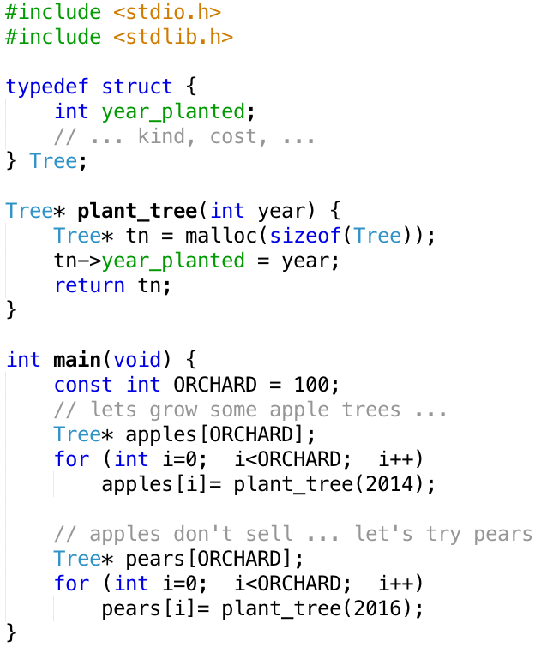
Using the Heap ... Example
New problem:
how do we get rid of the apple trees?
Need a way to free no longer used memory
or may eventually run out

